Slide 1
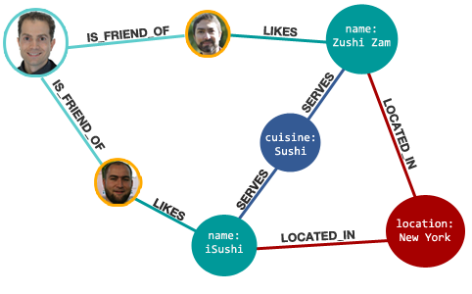
Neo4j Graph database
Thien Bui-Duc (FTI)
Email : hus.ict@gmail.com
Skype : neiht01
Facebook : www.facebook.com/tit001
1

Slide 2

2

Slide 3
is a
3

Slide 4
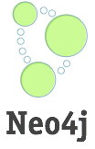
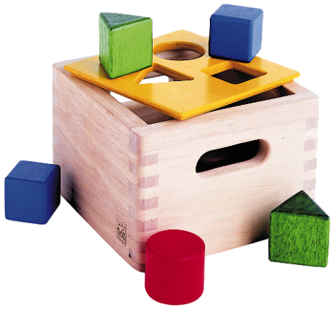
NOSQL
4

Slide 5
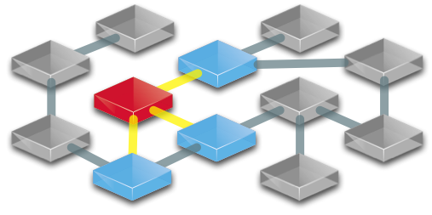
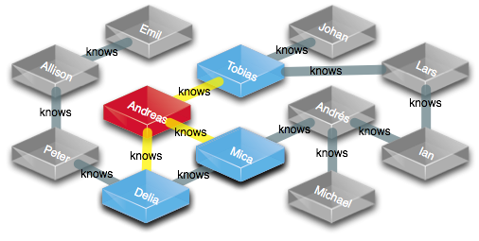
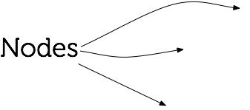

Properties (each a key+value)
Indexes (for easy look-ups)
5

Slide 6
How do you query this graph database?
6
Notes:
There existed a number of different ways to query a graph database. This one aims to make querying easy, and to produce queries that are readable.
We looked at alternatives - SPARQL, SQL, Gremlin and other...

Slide 7
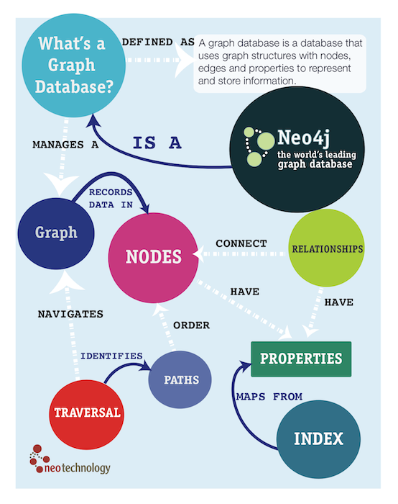
7

Slide 8
With a Graph Query Language:
Cypher
8
Notes:
There existed a number of different ways to query a graph database. This one aims to make querying easy, and to produce queries that are readable.
We looked at alternatives - SPARQL, SQL, Gremlin and other...

Slide 9
What is Cypher?
Pattern-Matching Query Language
Humane language
Expressive
Declarative: Say what you want, not how
borrows from well known query langs
Aggregation, Ordering, Limit
Update the Graph
9
Notes:
There existed a number of different ways to query a graph database. This one aims to make querying easy, and to produce queries that are readable.
We looked at alternatives - SPARQL, SQL, Gremlin and other...

Slide 10
It‘s all about Patterns
A
B
C
10

Slide 11
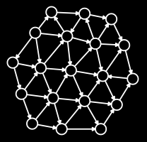
Patterns in a Graph
11

Slide 12
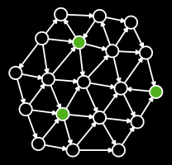
12

Slide 13
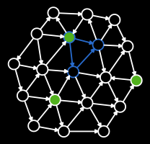
13

Slide 14
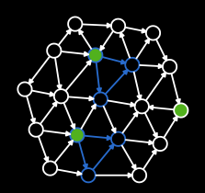
14

Slide 15
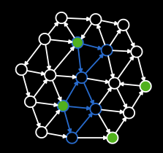
15

Slide 16
Patterns as ASCII-ART
() --> ()
16

Slide 17
Named Nodes
A
B
(A) --> (B)
17

Slide 18
Named Directed Rels
A
LOVES
B
A -[:LOVES]-> B
18

Slide 19
Paths
A
B
C
A --> B --> C
19

Slide 20
Cyclic-Path-Patterns
A
B
C
A --> B --> C, A --> C
A --> B --> C <-- A
20

Slide 21
Variable Length Paths
A
B
A
B
A
B
...
A -[*]-> B
21

Slide 22
The Parts of Cypher
22
Notes:
There existed a number of different ways to query a graph database. This one aims to make querying easy, and to produce queries that are readable.
We looked at alternatives - SPARQL, SQL, Gremlin and other...

Slide 23
Cypher: START + RETURN
START <lookup> RETURN <expressions>
START binds terms using simple look-up
directly using known ids
or based on indexed Property
RETURN expressions specify result set
// lookup node id 0, return that node
start n=node(0) return n
// lookup node in Index, return that node
start n=node:node_auto_index(name="Andreas") return n
// lookup all nodes, return all name properties
start n=node(*) return n.name
23

Slide 24
Cypher: MATCH
START <lookup> MATCH <pattern> RETURN <expr>
MATCH describes a pattern of nodes+relationships
node terms in optional parenthesis
lines with arrows for relationships
// lookup 'n', traverse any relationship to some 'm'
start n=node(0) match (n)--(m) return n,m
// any outgoing relationship from 'n' to 'm'
start n=node(0) match n-->m return n,m
// only 'KNOWS' relationships from 'n' to 'm'
start n=node(0) match n-[:Friend]->m return n,m
// from 'n' to 'm' and capture the relationship as 'r'
start n=node(0) match n-[r]->m return n,r,m
// from 'n' outgoing to 'm', then incoming from 'o'
start n=node(0) match n-->m<--o return n,m,o
24

Slide 25
Cypher: RETURN
RETURN <expressions>, aggregation(expr) as alias
RETURN nodes, rels, properties
RETURN expressions of functions and operators
RETURN aggregation functions on the above
// aggregate on n, count the m‘s
start n=node(0) match n--m return n,count(*)
// alias n.name as name
start n=node(0) return n.name as name
// aggregate m‘s into list
start n=node(*) match n--m return n,collect(m)
25

Slide 26
Cypher: WHERE
START <lookup> [MATCH <pattern>]
WHERE <condition> RETURN <expr>
WHERE filters nodes or relationships
uses expressions to constrain elements
// lookup all nodes as 'n', constrained to name 'Andreas'
start n=node(*) where n.name='Andreas‘ and n.age = 20 return n
// filter nodes where age is less than 30
start n=node(*) where n.age<30 return n
// filter using a regular expression
start n=node(*) where n.name =~ /Tob.*/ return n
// filter for a property exists
start n=node(*) where has(n.name) return n
26

Slide 27
Cypher: CREATE
CREATE <node>[,node or relationship] RETURN <expr>
create nodes with optional properties
create relationship (must have a type)
// create an anonymous node
create n
// create node with a property, returning it
create n={name:'Andreas'} return n
// lookup 2 nodes, then create a relationship and return it
start n=node(0),m=node(1) create n-[r:KNOWS]-m return r
// lookup nodes, then create a relationship with properties
start n=node(1),m=node(2) create n-[r:KNOWS {since:2008}]->m
27

Slide 28
Cypher: SET
SET [<node property>] [<relationship property>]
update a property on a node or relationship
must follow a START
// update the name property
start n=node(0) set n.name='Peter'
// update many nodes, using a calculation
start n=node(*) set n.size=n.size+1
// match & capture a relationship, update a property
start n=node(1) match n-[r]-m set r.times=10
28

Slide 29
Cypher: DELETE
DELETE [<node>|<relationship>|<property>]
delete a node, relationship or property
to delete a node, all relationships must be deleted first
// delete a node
start n=node(5) delete n
// remove a node and all relationships
start n=node(3) match n-[r]-() delete n, r
// remove a property
start n=node(3) delete n.age
29

Slide 30
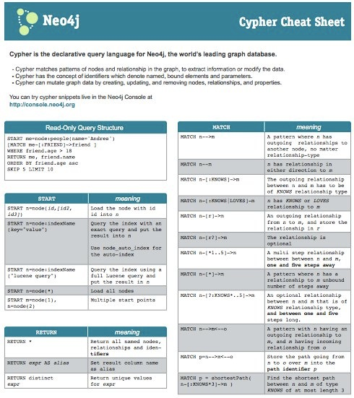
Cypher Cheat Sheet
http://neo4j.org/resources/cypher
30

Slide 31

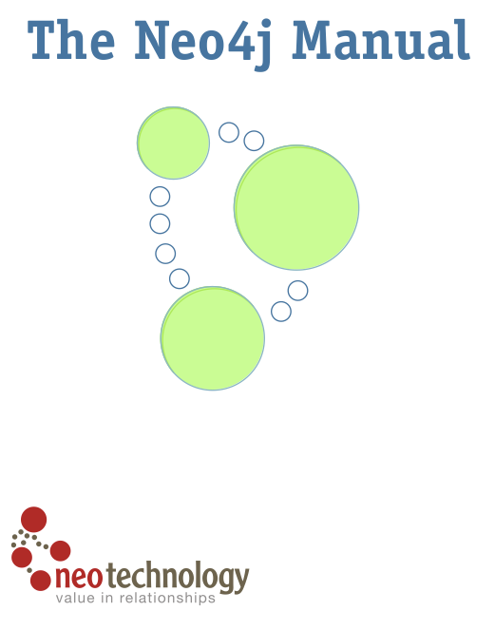



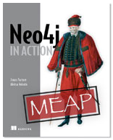
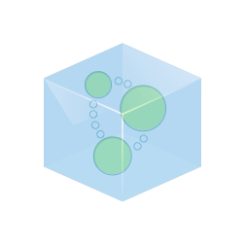

How to get started?
Documentation
docs.neo4j.org - tutorials+reference
http://console.neo4j.org
Neo4j in Action
Good Relationships
Get Neo4j
http://neo4j.org/download
http://addons.heroku.com/neo4j/
Participate
http://groups.google.com/group/neo4j
http://neo4j.meetup.com
a session like this one ;)
31

Slide 32
Exercise:
Create Mini graph app with cypher queries.
Ex: The Movie Graph
Pop-cultural connections
The Movie Graph is a mini graph application containing actors and directors that are related through the movies they've collaborated on.
This will show you how to:
Create: insert movie data into the graph
Find: retrieve individual movies and actors
Query: discover related actors and directors
32

Slide 33


